Slide 1
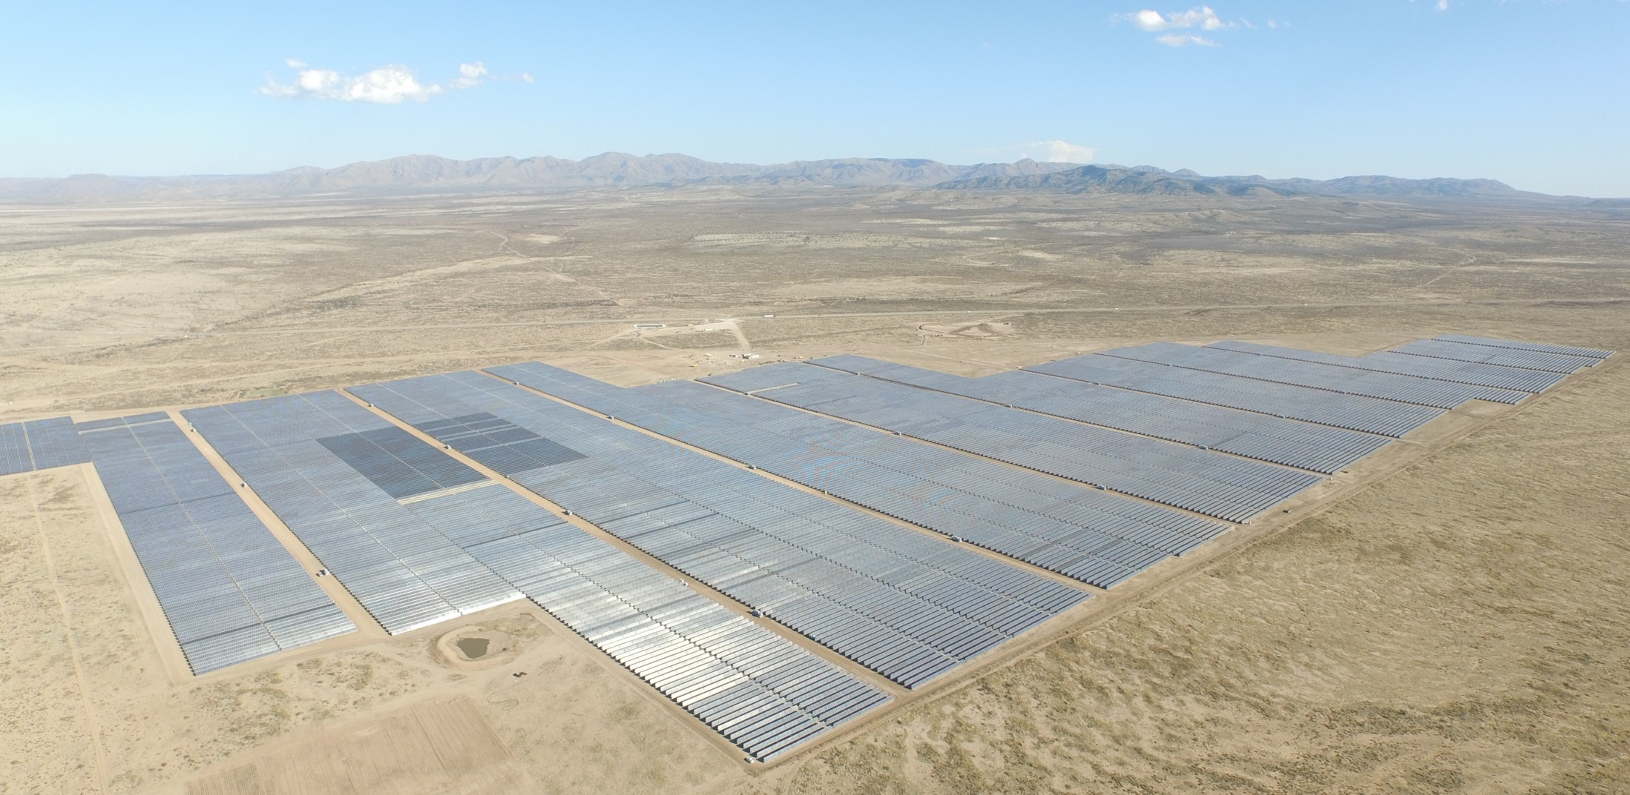
50 mega Watt (AC) Solar farm – 350 Acres - Alpine, Texas.
Energy Harvest for the City of Houston. View looking ESE
Solairedirect / Engie Solar – developer of the project

Slide 2
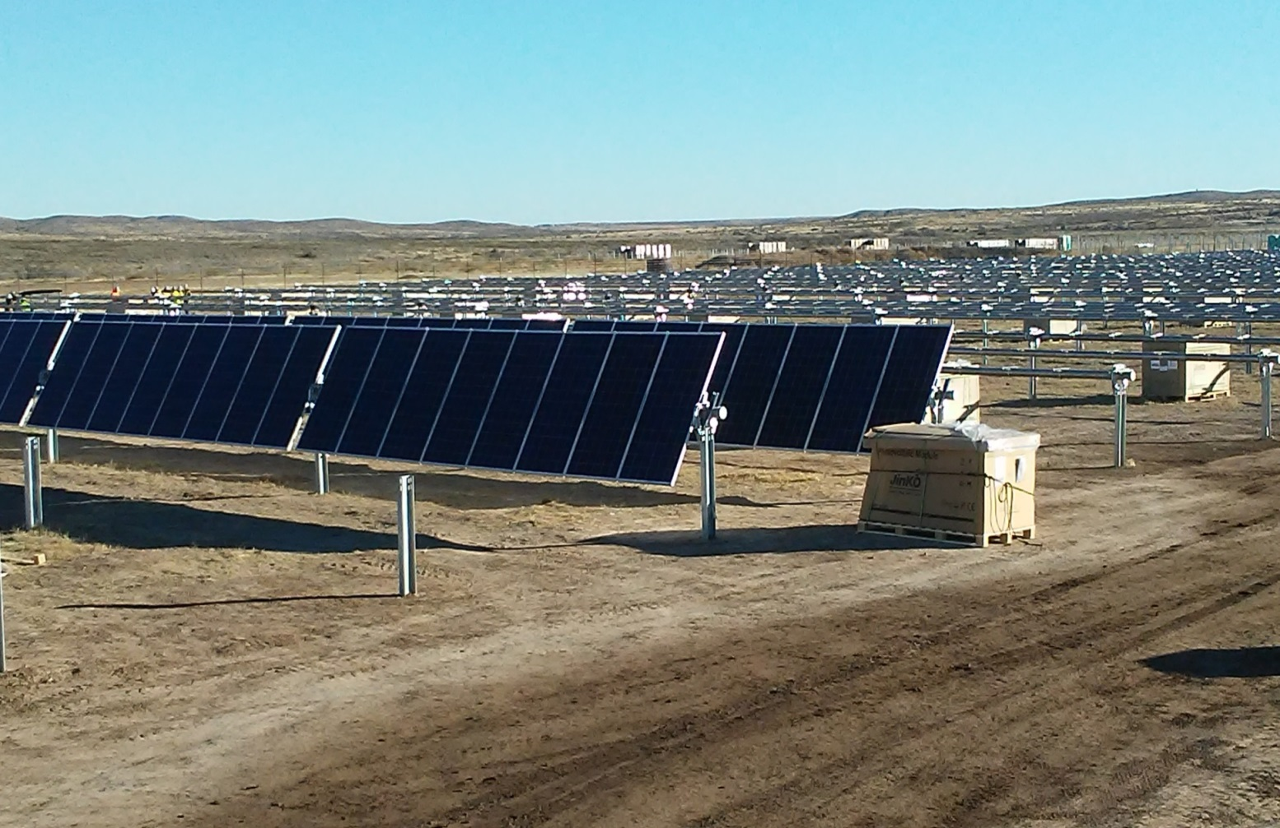
The Trackers were designed by NexTracker.com, the dominant tracker manufacturer

Slide 3
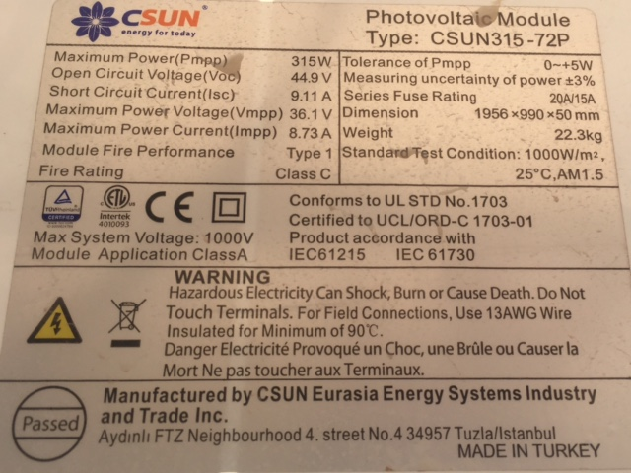
315 watt solar panel –197,000 Panels
Note that the were made in Turkey.

Slide 4
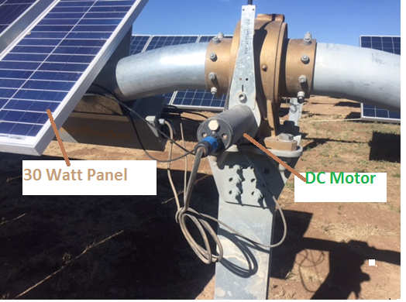
Mechanism to tilt 80 panels – 25.2 k Watts; 40 to left,40 to right
1. Small panel on the left provides power for tilt motor – 30 watts.
2. Worm gearbox is being driven by a small DC motor. – The duty cycle is intermittent.
3. Wifi antenna (top, partially visible) - communication.
4. The bent tube allows the center of gravity of the array to be located on the axis of rotation.

Slide 5
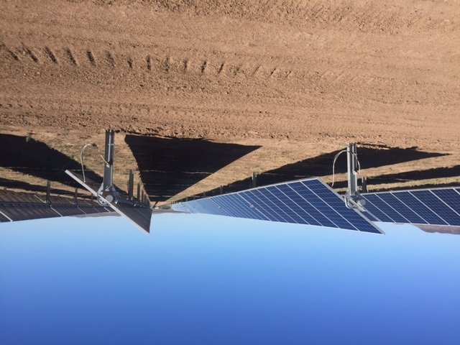
Early morning deployment.
Max tilt angle is so one row does not shade the next row.

Slide 6
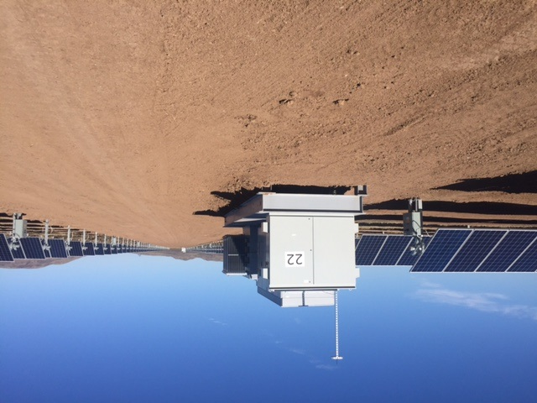
Looking west – with 2 mega watt inverter from Kaco in San Antonio – 1 of 26.
Now the inverters are 3 Mega watt each.

Slide 7
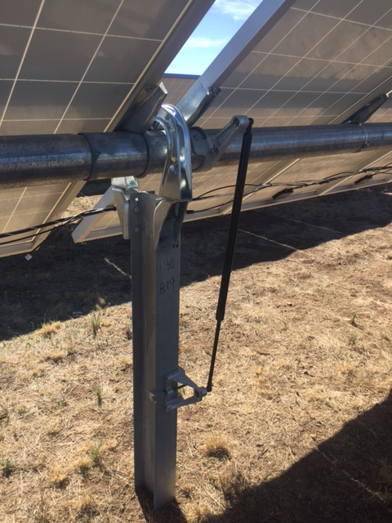
Shock absorber to dampen out any wind induced vibrations. I noted that the natural frequency of vibration of the beam was 2 cycles per second. Rule of thumb, 2 cycles or higher to avoid flutter.

Slide 8
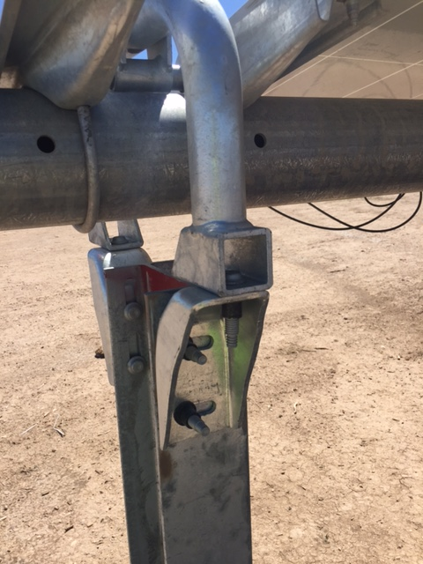
Intermediate support. The 5” EMT horizontal tube supports the panels. The columns are driven into the soil (30 seconds -typical drive time), using GPS to locate them. The brackets shown, allow slight adjustment, in 3 dimensions.

Slide 9
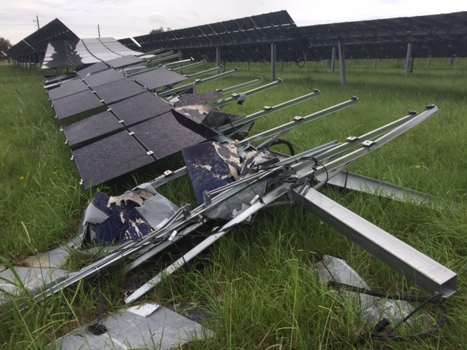
Google: Local Sun Energy in Sealy, Tx
Destruction due to a microburst – late May,2017

Slide 10
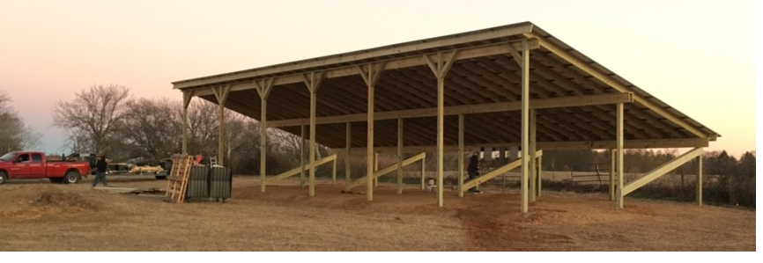
Array – 32’ x 81’ before a high wind event.
The wind flipped the some panels off of the structure as a monolith. The panels were together, as well as tied to the wooden frame. There may have been thermal cycling, weakening the fasteners.

